Slide 1
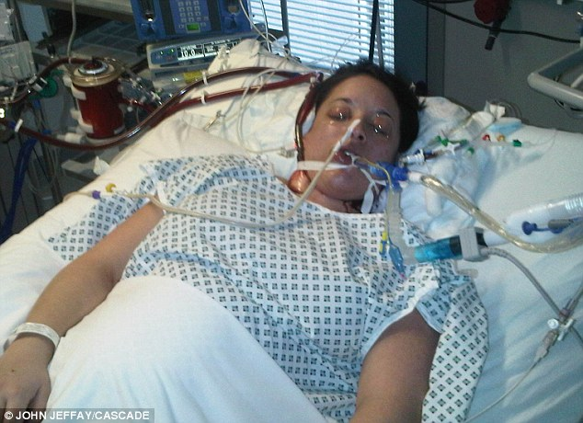
Medical disorders in pregnancy
Dr Carmeline Motha,
Consultant physician & Senior lecturer,
Faculty of medicine,
Ragama

Slide 2
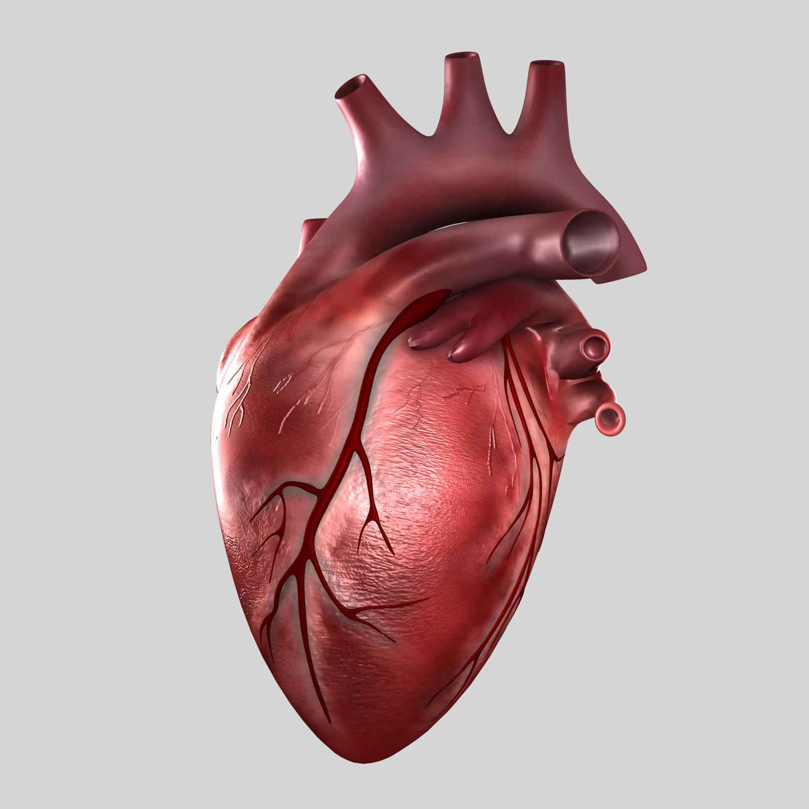
Heart disease
Heart disease

Slide 3

Preconception care

Slide 4
Preconception care
Contraindications to pregnancy (WHO IV)
Pulmonary hypertension of any cause
Left ventricular dysfunction
LVEF<30%
NYHA III/IV
H/O peripartum cardiomyopathy with residual impairment of cardiac function
Severe MS/symptomatic severe AS
Marfans syndrom with marked aortic root dialatation

Slide 5
Preconception care
Multidisciplinary management
Optimise patient’s cardiac status
Optimise Haemoglobin
Risk of heart disease in the fetus (fetal echo)
risk higher if mother has cong heart disease
risk higher for outflow tract lesions
Marfan and HOCM-AD inheritance

Slide 6
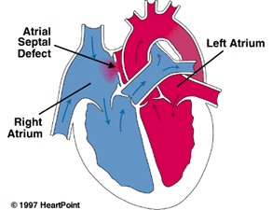
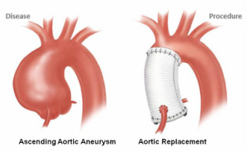
Congenital heart disease
Commonest lesions
ASD/VSD/PDA
Marfan’s, syndrome
C/I if aortic root>45mm
Regular echocardiograms to monitor aortic diameter
Elec SC if aortic root >45mm

Slide 7
Cyanotic congenital heart disease
Risk
worsening cyanosis(increased R-L shunting)
increased thrombophilic risk
increased risk of fetal loss and IUGR(If SaO2<85%)
pulmonary hypertension

Slide 8
Cyanotic congenital heart disease
Pregnancy outcome improved if
Resting O2 sat >85%
Hb<18g/dl
Haematocrit <55%
Thromboprophylaxis

Slide 9
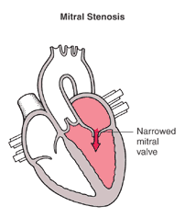
Acquired heart disease
Rheumatic heart disease commonest
MS
Can deteriorate during pregnancy even though asymptomatic at beginning of pregnancy
Tachycardia triggers this
Regurgitant valve disease-usually well tolerated in absence of LV dysfunction

Slide 10
Infective endocarditis
Not routinely indicated
Indications:
H/O IE
High risk lesion(artificial heart valves)

Slide 11
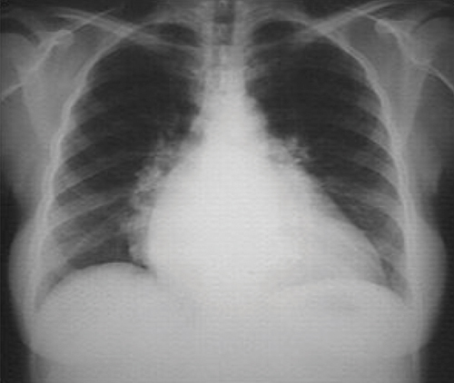
Peripartum cardiomyopathy
Developemnt of heart failure occuring during the last month of pregnancy upto 5 months postpartum in the absence of a known cause.
Risk factors
Multiple pregnancy
Multiparity
Gestational HT
Advanced maternal age

Slide 12
Peripartum cardiomyopathy
Aetiology- ?autoimmune
myocarditis on endomyocardial biopsy
Management- conventional treatment
50% - full recovery
Risk of recurrence in future pregnancy even if fully recovered
C/I for pregnancy if residual LV dysfunction

Slide 13
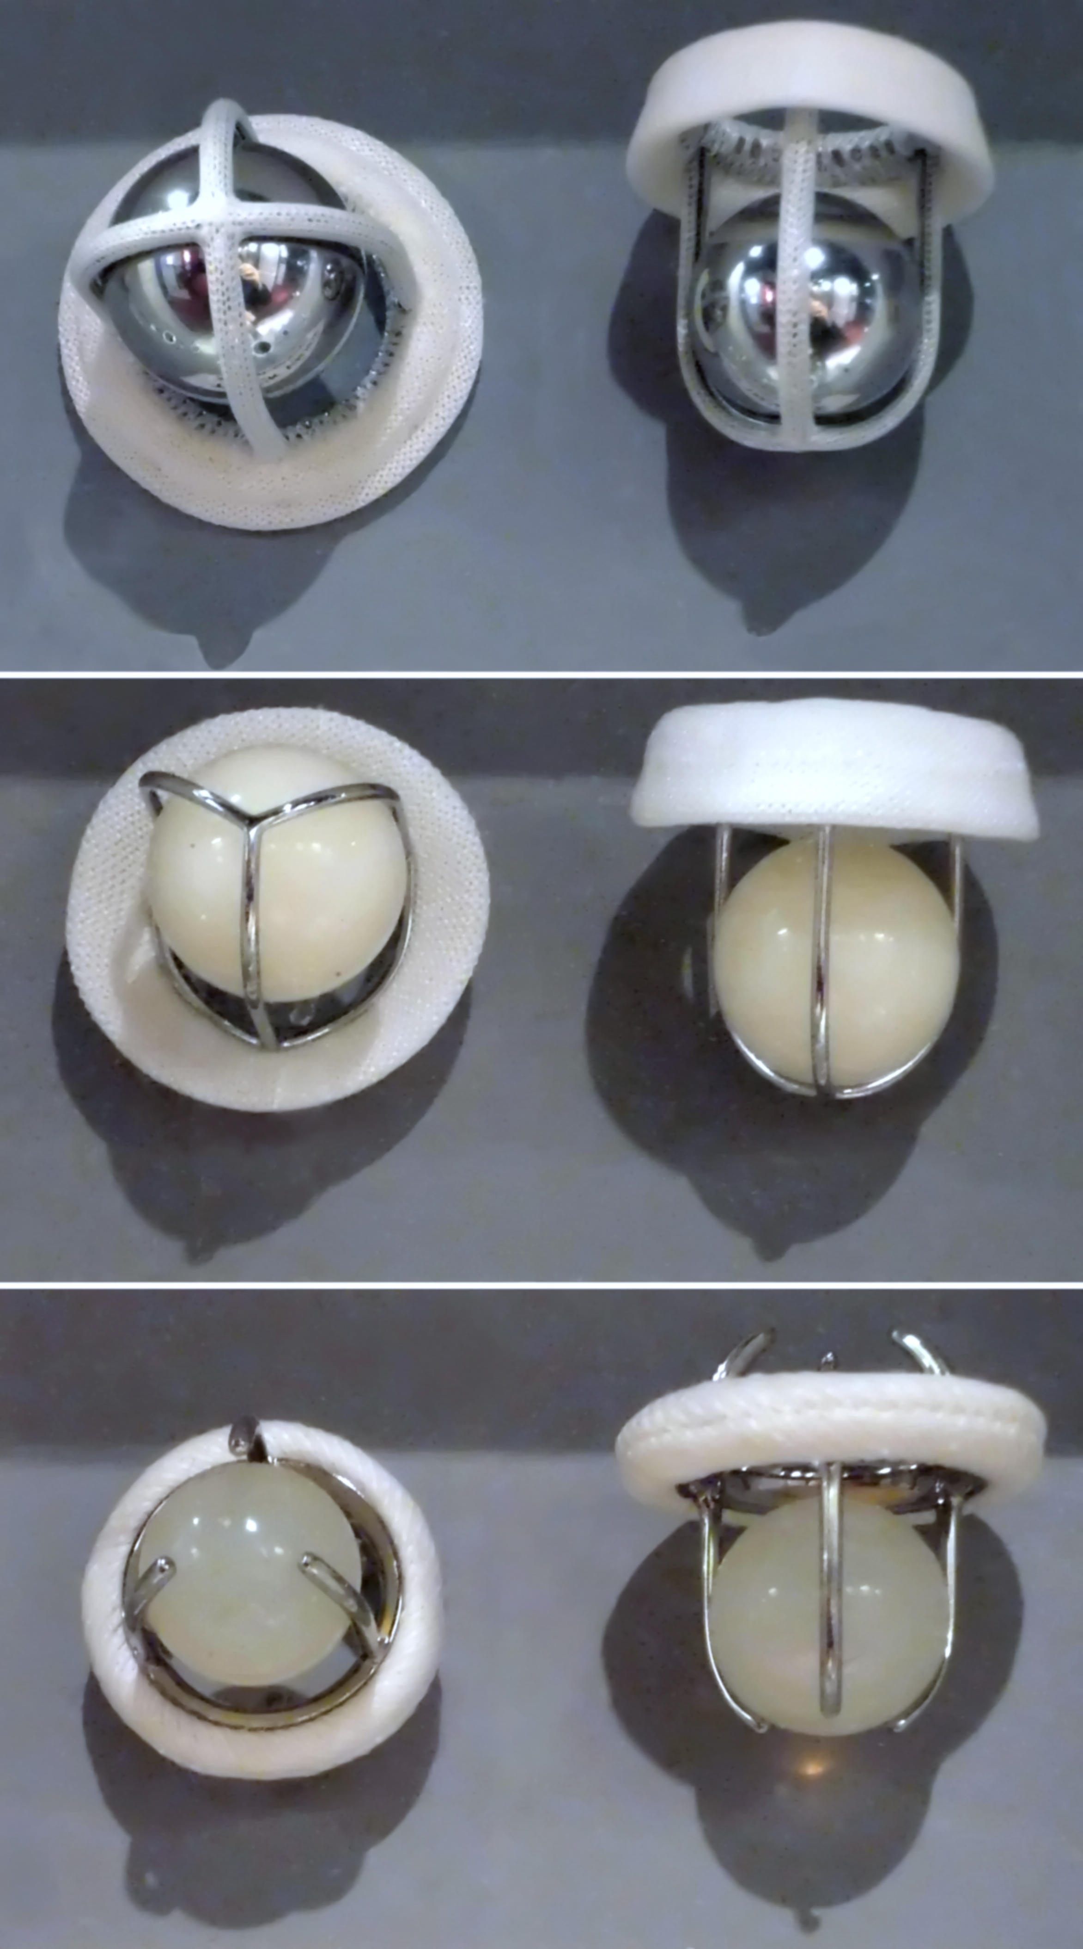
Artificial heart valves
Anticoagulate
Heparin/warfarin?
Risk of maternal thrombosis is higher with heparin
Risk of teratogenesis, miscarriage, stillbirth and IC bleed in the fetus with use of warfarin

Slide 14
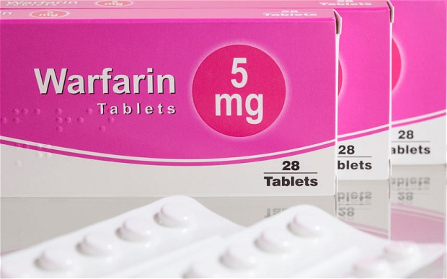
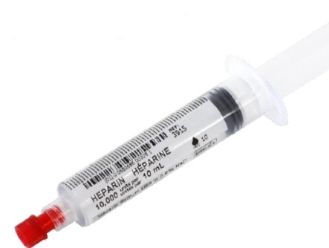
Anticoagulation
3 broad anticoagulation regimes
Warfarin throughout pregnancy
Heparin between 6-12 weeks followed by warfarin
Heparin throughout pregnancy

Slide 15
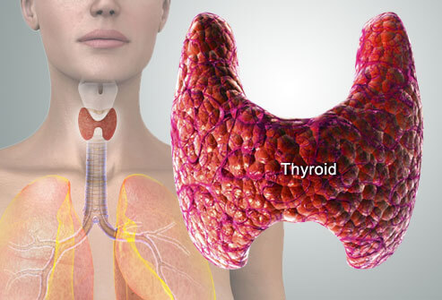
Thyroid dysfunction in pregnancy

Slide 16
Trimester | SerumTSH (µIU/mL) | FT4 (pg/ml)
First | 0.1-2.5 | 0.83-1.27
Second | 0.2-3.0 | 0.71-1.05
third | 0.3-3 .0 | 0.72-1.06
Non pregnant | O.4-4.0 | 0.56-1.04

Slide 17
Hypothyroidism in pregnancy
Autoimmune thyroid dysfunction
Iodine deficiency

Slide 18
Overt hypothyroidism
Gestational hypertension
Placental abruption
Miscarriage
Premature birth
Low birth weight
Neonatal respiratory distress
Impaired neurocognitive development in the offspring
- Treatment is indicated

Slide 19
Subclinical hypothyroidism
Shown to be associated with adverse pregnancy outcomes
Treatment indicated

Slide 20
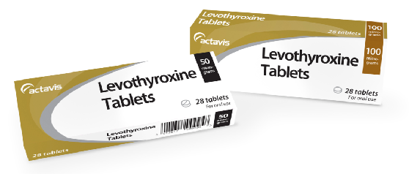
Management of hypothyroidism
Levothyroxine replacement
TFT should be monitored 6 weekly

Slide 21
Hyperthyroidism in pregnancy
Graves disease
Toxic multinodular goiter
Toxic adenoma

Slide 22
Overt hyperthyroidism
Gestational hypertension
Thyroid storm
Maternal congestive heart failure
Miscarriage
Prematurity
Low birth weight
Fetal growth restriction
Stillbirth
Neonatal goitre
- Treatment is indicated

Slide 23
Hyperthyroidism
Aim to maintain thyroxin in a upper normal range with the minimum dose of antithyroid medication

Slide 24
Subclincal hyperthyroidism
Treatment not indicated

Slide 25
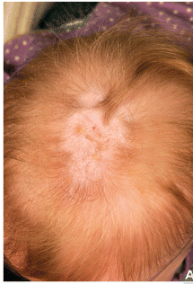
Management of hyperthyroidism
Antithyroid drugs
Propylthoiuracil (PTU) in the first trimester of pregnancy.
Carbimazole from the second trimester onwards.

Slide 26
